Slide 1
DOMESTIC VIOLENCE
SURVIVORS JUSTICE ACT:
APPLICATION FOR RESENTENCING
Presented by:
Alan Rosenthal

Slide 2
Relevant New Statutes
Penal Law § 60.12 (Amended)
▪ Domestic Violence Alternative Sentence
▪ Effective May 14, 2019
CPL § 440.47 (New)
▪ Application for Resentencing
▪ Effective August 12, 2019
Notes:
Sentencing – applies to offenses committed on, after, and prior to the effective date of May 14, 2019 where the sentence for such offense has not yet been imposed.
Resentencing - applies to offenses committed prior to the effective date , August 12, 2019.
Materials pages 3-9.

Slide 3
PENAL LAW § 60.12
Provides for an alternative sentence for all new sentences on or after May 14, 2019 if defense counsel can establish that the defendant was a survivor of domestic violence and meets the statutory criteria

Slide 4
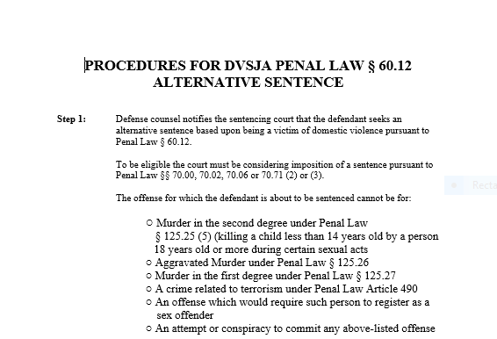
Notes:
Page 10 of materials

Slide 5

Notes:
PL 60.12 contains the following proviso: “A court may determine that such abuse constitutes a significant contributing factor pursuant to paragraph (b) of this subdivision regardless of whether the defendant raised a defense pursuant to article thirty-five, article forty, or subdivision one of section 125.25 of this chapter.”

Slide 6
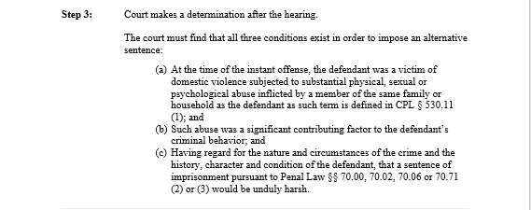
Notes:
Note the problem with the third step of the analysis contained in (c), which if read literally would create an impossibility to ever prove that a possible sentence under any of those Penal Law provisions would be unduly harsh. For indeed there are some sentences available under 70.00 that would allow for an unconditional discharge. To make sense it must be read as meaning that the sentences provided for in the specific sentencing structure and class of offense is unduly harsh.

Slide 7
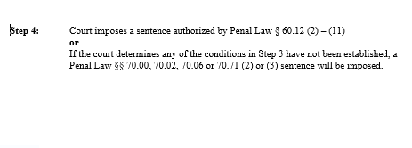

Slide 8
Penal Law § 60.12
Key Terminology
At the time of the instant offense, the defendant was a victim of domestic violence subjected to substantial physical, sexual or psychological abuse inflicted by a member of the same family or household…
Such abuse was a significant contributing factor to the defendant’s criminal behavior; and
Having regard for the nature and circumstances of the crime and the history, character and condition of the defendant, a traditional sentence would be unduly harsh
Notes:
Substantial - real, meaningful,
Significant – sufficiently great or important to be worthy of attention, meaningful, important
Unduly Harsh – Parsimonious – “sufficient, but not greater than necessary”

Slide 9
Penal Law § 60.12
Other Key Terminology
At the time of the instant offense, the defendant was a victim of domestic violence subjected to substantial physical, sexual or psychological abuse inflicted by a member of the same family or household as the defendant…

Slide 10
“Member of the Same Family or Household”
CPL § 530.11 ….shall mean the following:
Persons related by consanguinity or affinity;
Persons legally married to one another;
Persons formerly married to one another regardless of whether they still reside in the same household;
Person who have a child in common, regardless of whether such persons have been married or have lived together at any time; and
Persons who are not related by consanguinity or affinity and who are or have been in an intimate relationship regardless of whether such persons have lived together at any time.

Slide 11
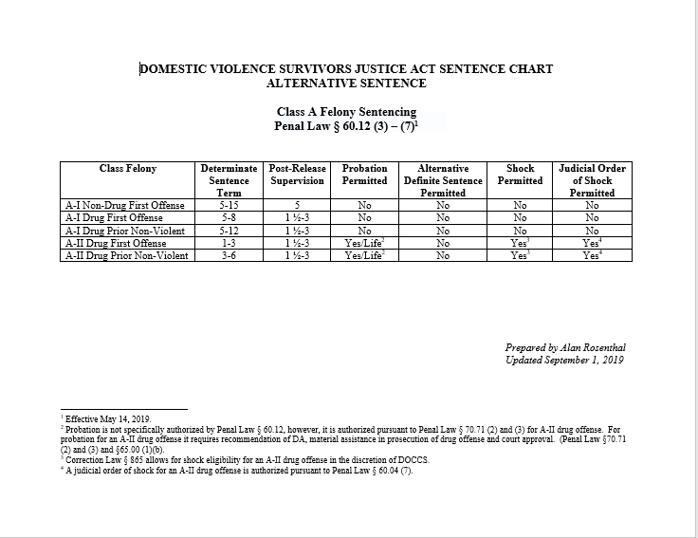
Notes:
Pages 12-14 of materials

Slide 12
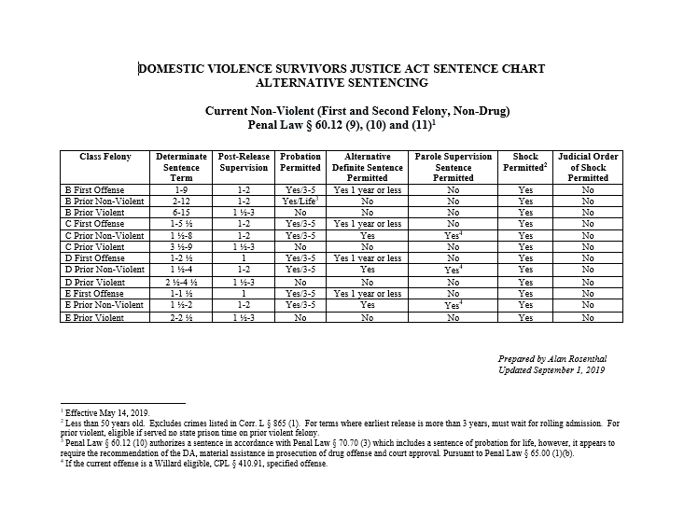

Slide 13
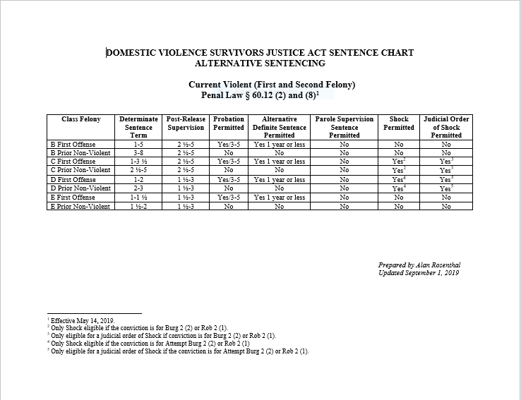

Slide 14
CPL § 440.47
Motion for Resentence:
Domestic Violence Cases
Provides for resentencing if defense counsel can establish that the defendant was a victim of domestic violence and meets the statutory criteria

Slide 15
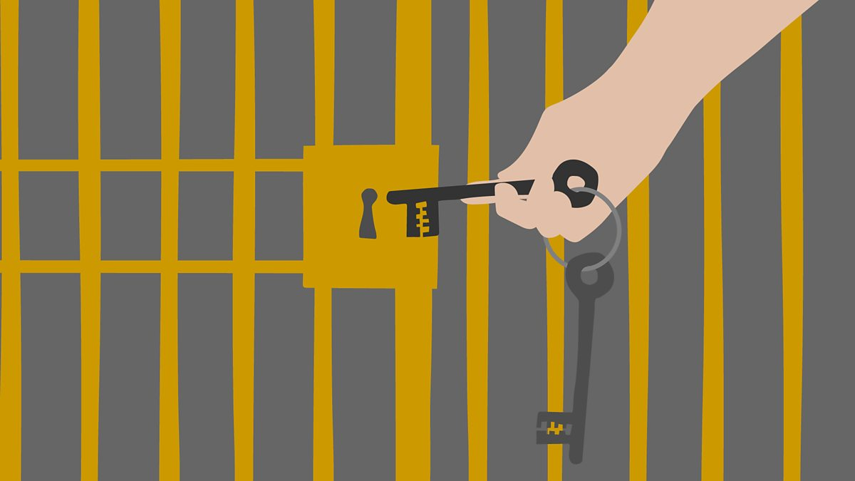
CPL § 440.47
Motion for Resentence:
DO YOU HOLD THE KEYS?

Slide 16
CPL § 440.47
Motion for Resentence:
Domestic Violence Cases
● Lessons learned from the DLRA
● Taking a proactive approach
● Outreach letter to potentially eligible prisoners
● Letter includes an initial eligibility questionnaire

Slide 17
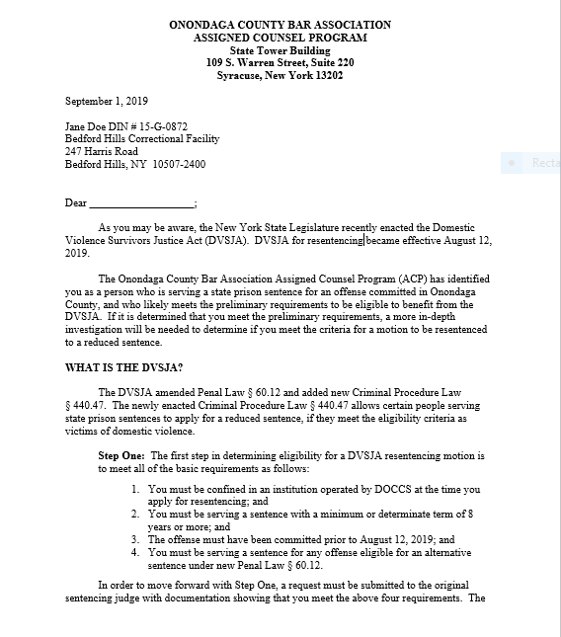
Sample Outreach Letter
Notes:
See sample letter on page 15 of materials

Slide 18
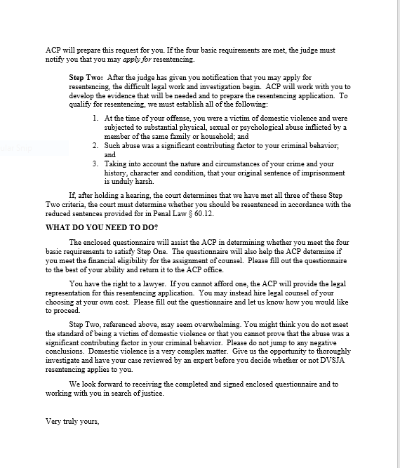
Sample Outreach Letter
Notes:
See sample letter on page ____ of materials

Slide 19
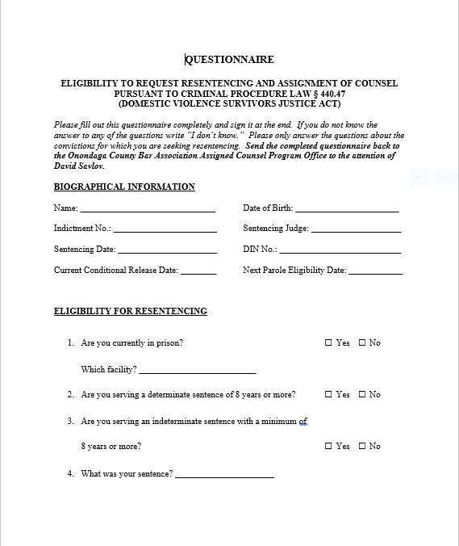
Initial Questionnaire
Notes:
See questionnaire on pages 17-19 of materials

Slide 20
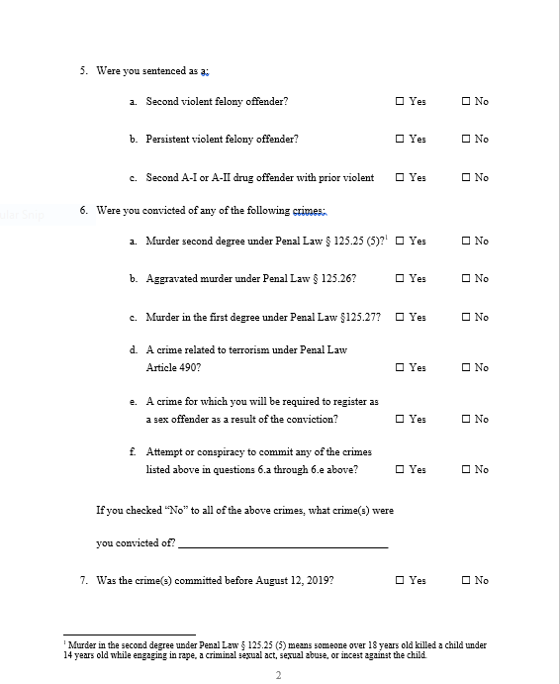
Initial Questionnaire

Slide 21
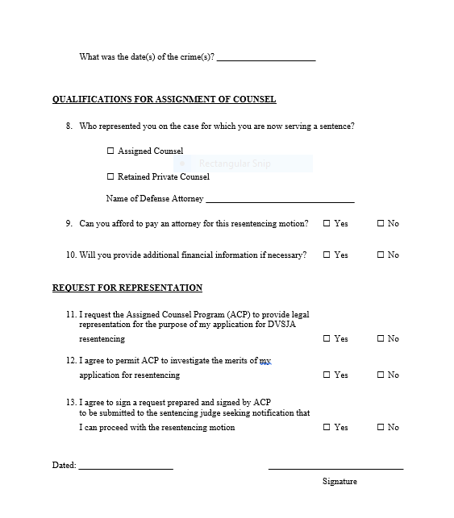
Initial Questionnaire

Slide 22
DVSJA CPL § 440.47
Resentencing Application Process
STEP BY STEP

Slide 23
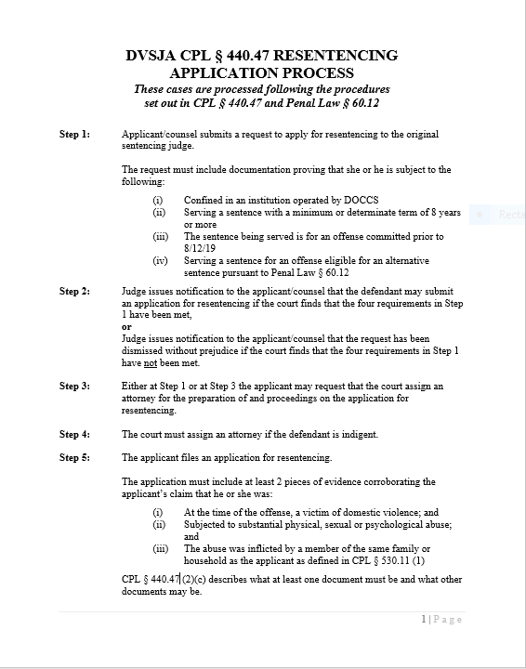
Notes:
See pages 20-22 of materials

Slide 24
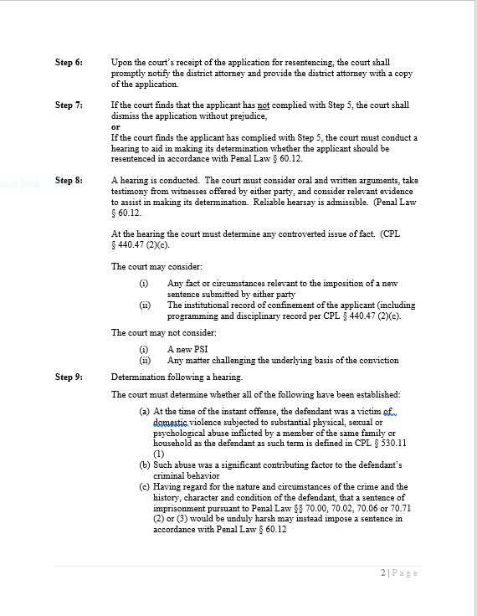

Slide 25
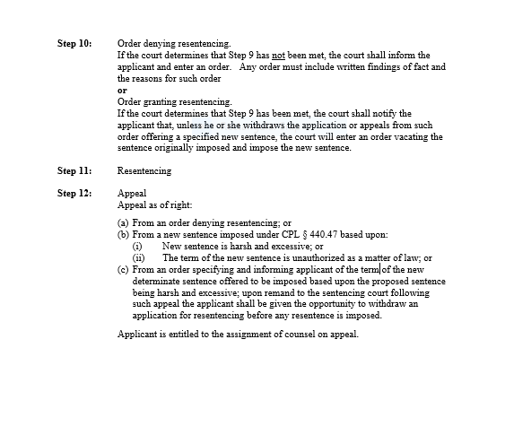

Slide 26
DVSJA RESENTENCING PROCESS
Step 1: Applicant/counsel submits a request to apply for resentencing to the original sentencing judge.
The request must include documentation proving that she or he is subject to all of the following:
(i) Confined in an institution operated by DOCCS
(ii) Serving a sentence with a minimum or determinate terms of 8 years or more
(iii) Sentence for an offense committed prior to 8/12/19
(iv) Serving a sentence for an offense eligible for alternative sentencing

Slide 27
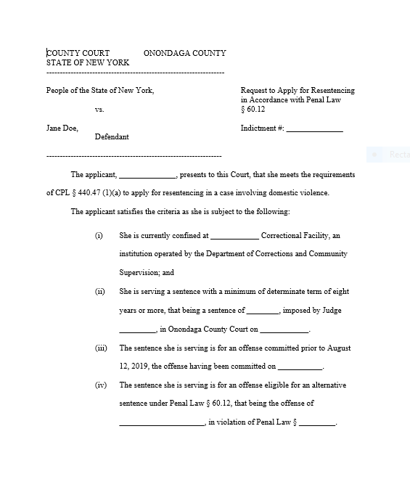
REQUEST TO APPLY FOR RESENTENCING
Notes:
See materials p. 25-26.

Slide 28
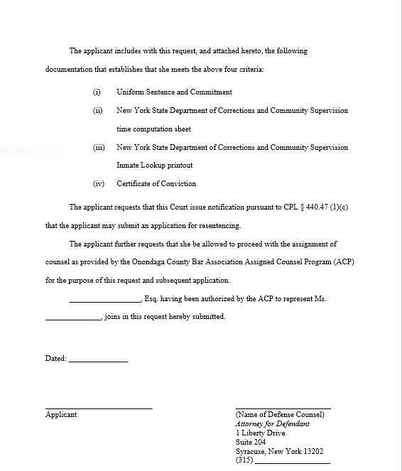
REQUEST TO APPLY FOR RESENTENCING
Notes:
See material p. 26.

Slide 29
WHAT DOCUMENTATION SHOULD BE INCLUDED WITH THE REQUEST TO SATISFY THE FOUR ELIGIBILITY CRITERIA?
● Uniform Sentence and Commitment
● DOCCS Time Computation Sheet
● DOCCS Inmate Lookup Printout
● Certificate of Conviction (or similar document)
Notes:
Not all are necessary but must be sufficient documentation to establish the 4 criteria for eligibility.

Slide 30
DVSJA RESENTENCING PROCESS
Step 2: Judge issues notification to the applicant/counsel that the defendant may submit an application for resentencing if the court finds that the four requirements in Step 1 have been met,
or
Judge issues notification to the applicant /counsel that the request has been dismissed without prejudice if the court finds that the four requirements in Step 1 have not been met.
Notes:
Sample Judicial Notification is found on page 27 of materials. You may choose to submit it to Judge as proposed notification for Judge to sign.

Slide 31
DVSJA RESENTENCING PROCESS
Step 3: Either at Step 1 or at Step 3 the applicant may request that the court assign an attorney for the preparation of and proceeding on the application for resentencing.
Step 4: The court must assign an attorney if the defendant is indigent.

Slide 32
DVSJA RESENTENCING PROCESS
Step 5: The applicant files an application for resentencing.
The application must include at least 2 pieces of evidence corroborating the applicant’s claim that he or she was:
(i) At the time of the offense, a victim of domestic violence; and
(ii) Subjected to substantial physical, sexual or psychological abuse; and
(iii) The abuse was inflicted by a member of the same family or household as the applicant.

Slide 33
DVSJA RESENTENCING PROCESS
Step 5: ● CPL § 440.47 (2)(c) describes what at least one document must be and what other documents may be.
● Without at least two pieces of evidence the application will fail
● See materials – Evidentiary Eligibility Checklist

Slide 34
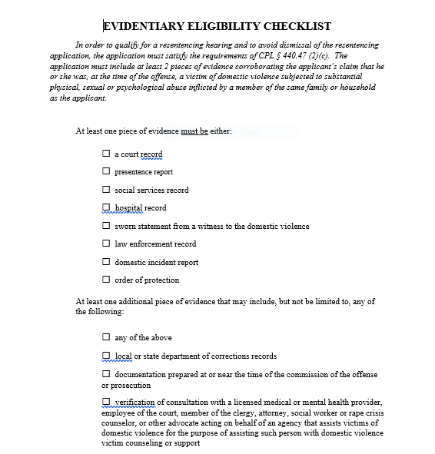
EVIDENTIARY ELIGIBILITY CHECKLIST
Notes:
See page 28 of materials

Slide 35
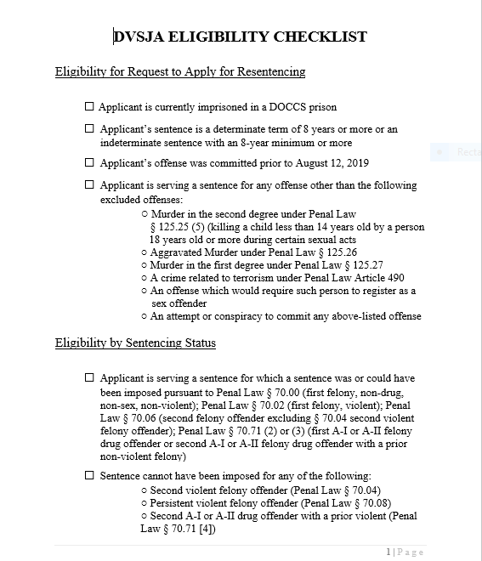
DVSJA ELIGIBILITY CHECKLIST
Notes:
See pages 23-24 of materials

Slide 36
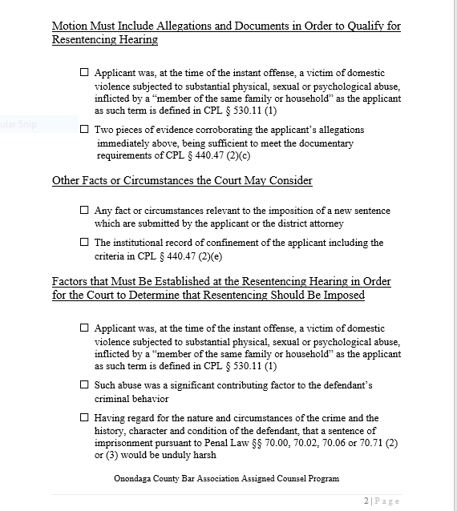
DVSJA ELIGIBILITY CHECKLIST
Notes:
See page 23-24 of materials

Slide 37
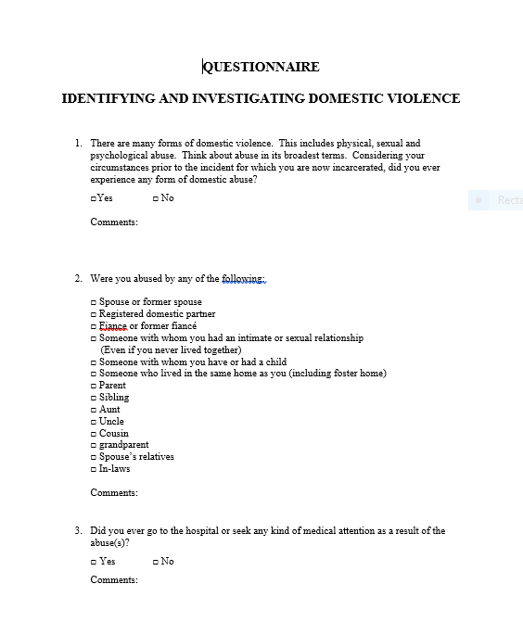
QUESTIONNAIRE:
IDENTIFYING AND INVESTIGATING DOMESTIC VIOLENCE
Notes:
See pages 29-31 of materials

Slide 38
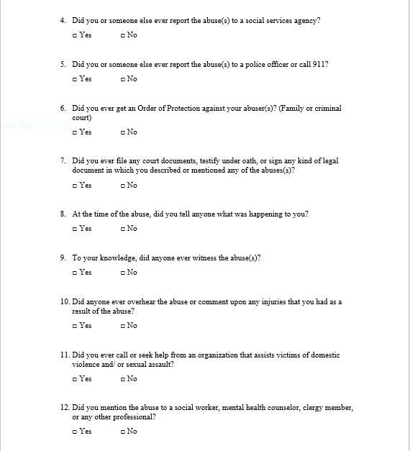
QUESTIONNAIRE:
IDENTIFYING AND INVESTIGATING DOMESTIC VIOLENCE
Notes:
See page ____ of materials

Slide 39
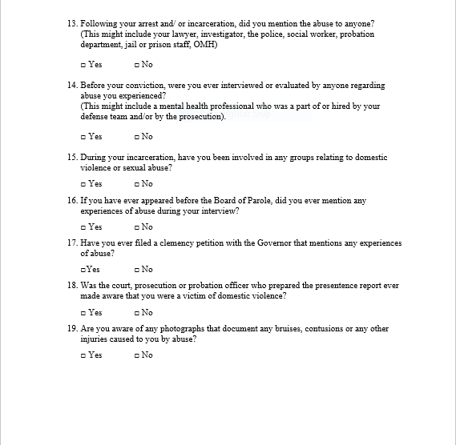
QUESTIONNAIRE:
IDENTIFYING AND INVESTIGATING DOMESTIC VIOLENCE
Notes:
See page ____ of materials

Slide 40
RESENTENCING APPLICATION
● Notice of Application
● Attorney’s Affirmation
● Exhibits/ Attachments
Notes:
See page ____ of materials

Slide 41
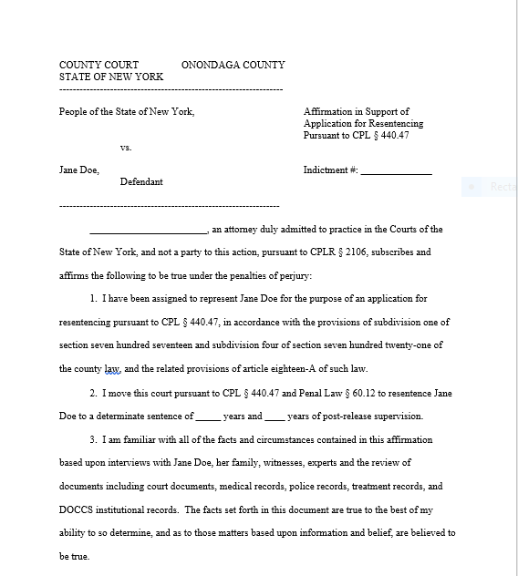
RESENTENCING APPLICATION
Notes:
See page 32-43 of materials

Slide 42
DVSJA RESENTENCING PROCESS
Step 6: Upon the court’s receipt of the application for resentencing, the court shall promptly notify the district attorney and provide the district attorney with a copy of the application.

Slide 43
DVSJA RESENTENCING PROCESS
Step 7: If the court finds the applicant has not complied with Step 5, the court shall dismiss the application without prejudice,
or
If the court finds the applicant has complied with Step 5, the court must conduct a hearing to aid in making the determination whether the applicant should be resentenced in accordance with Penal Law § 60.12.

Slide 44
DVSJA RESENTENCING PROCESS
Step 8: A hearing is conducted. The court must consider oral and written arguments, take testimony from witnesses offered by either party, and consider relevant evidence to assist in making its determination.
At the hearing the court must determine any controverted issue of fact. [CPL § 440.47 (2)(c)].

Slide 45
DVSJA RESENTENCING PROCESS
Step 8: More on the hearing.
● The court may consider:
(i) Any fact or circumstances relevant to the imposition of a new sentence submitted by either party
(ii) The institutional record of confinement of the applicant [including programming and disciplinary record per CPL § 440.47 (2)(c)].
● The court may not consider:
(i) A new PSI
(ii) Any matter challenging the underlying bases of the conviction

Slide 46
DVSJA RESENTENCING PROCESS
Step 9: Determination following a hearing.
The court must determine whether the following have been established:
(a) At the time of the instant offense, the defendant was a victim of domestic violence subjected to substantial physical, sexual or psychological abuse inflicted by a member of the same family or household as the defendant.
(b) Such abuse was a significant contributing factor to the defendant’s criminal behavior.
(c) The previously imposed sentence is unduly harsh when considered having regard for the nature and circumstances of the crime and the history, character and conditions of the defendant.
Notes:
Note that with regard to the “unduly harsh” finding the cross reference to the methodology of Penal Law § 60.12 does not quite work and takes some reworking of the final step of the analysis.

Slide 47
DVSJA RESENTENCING PROCESS
Step 9: Determination following a hearing.
● The third finding that the court must make under Penal Law § 60.12 (1)(c) actually reads as follows:
(c) having regard for the nature and circumstances of the crime and the history, character and condition of the defendant, that a sentence of imprisonment pursuant to section 70.00, 70.02, 70.06 or subdivision two or three of 70.71 of this title would be unduly harsh.
● But that language doesn’t work for resentencing, and makes sense only when read as follows:
(c) having regard for the nature and circumstances of the crime and the history, character and conditions of the defendant, the previously imposed sentence is unduly harsh.
Notes:
Note that with regard to the “unduly harsh” finding the cross reference to the methodology of Penal Law § 60.12 does not quite work and takes some reworking of the final step of the analysis.
Anticipate this issue coming up.

Slide 48
DVSJA RESENTENCING PROCESS
Step 10: Order denying resentencing.
If the court determines that Step 9 has not been met, the court shall inform the applicant and enter an order. Any order must include written findings of fact and reasons for such order,
or
Order granting resentencing.
If the court determines that Step 9 has been met, the court shall notify the applicant that, unless he or she withdraws the application or appeals from such order offering a specified new sentence, the court will enter an order vacating the sentence originally imposed and impose the new sentence.

Slide 49
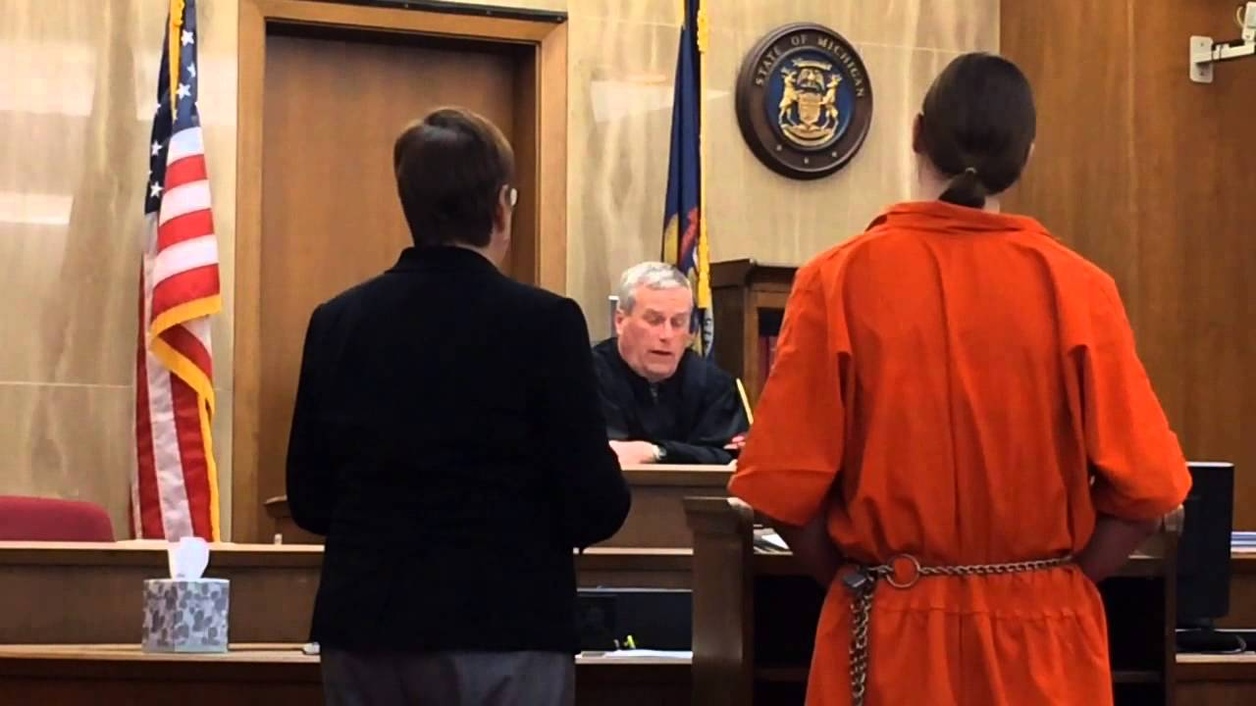
DVSJA RESENTENCING PROCESS
Step 11: Resentencing

Slide 50
DVSJA RESENTENCING PROCESS
Step 12: Appeal
Appeal as of right:
(a) From an order denying resentencing, or
(b) From a new sentence imposed under CPL § 440.47
based upon:
(i) New sentence is harsh and excessive, or
(ii) The term of the new sentence is unauthorized as a matter of law, or
(c) From an order specifying and informing applicant of the term of the new determinate sentence offered to be imposed based upon the proposed sentence being harsh and excessive; upon remand to the sentencing court following such appeal the applicant shall be given the opportunity to withdraw an application for resentencing before any resentence is imposed.
Applicant is entitled to the assignment of counsel on appeal.

Slide 51
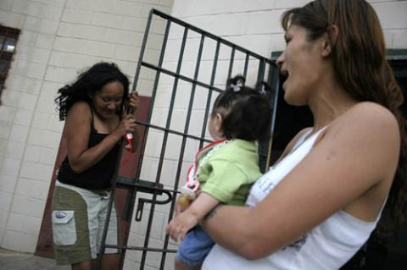
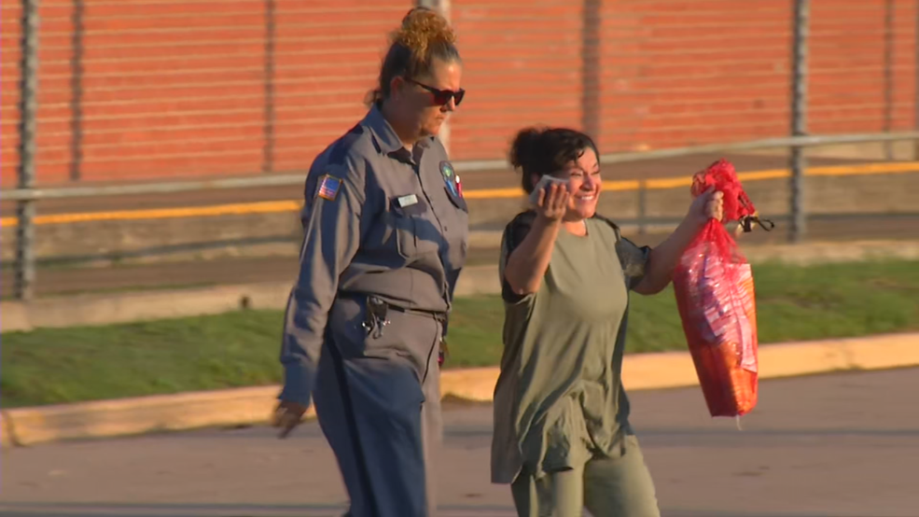
DVSJA RESENTENCING:
YOU CAN MAKE THIS HAPPEN

Slide 52
Selected Issues
Burden of proof
Institutional record of confinement – record request
“At the time of the instant offense, the defendant was a victim of domestic violence…”
See legislative history and statutory language changes
Abuse was “a significant contributing factor”
▪ Use of experts and social science literature
• Sentence “unduly harsh”
Notes:
Burden of Proof – Preponderance of the evidence
Records – sentence and commitment order, legal date computation, computer printout of discipolinary record, program assignments, misbehavior reports, program evaluations, certificates, quarterly evaluations.
“At the time of offense…” – 1) need not be contemporaneous – how remote; 2) Need not be victim of dv of person against whom crime committed
Statutory language changes – “defendant was [the] a victim of domestic violence
- …abuse [by the victim or intended victim of such offense] inflicted by a member of the same family or household…

Slide 53
Selected Issues
Use of investigator
In-person interview
Use of a mitigation specialist
Difficult issues to address with client
  ▪ What alternative sentence to request for resentencing
  ▪ Be patient – Wait to improve institutional record
Prioritizing for people about to be released from prison – People v. Santiago, 17 N.Y.3d 246 (2011)
Notes:
Prioritizing for prisoners about to be released – Since one of the criteria to apply for resentencing is that the person must be confined in a DOCCS facility, concern must be taken with regard to potential applicants who are nearing their release date. What happens if they apply before being released but are subsequently released before the resentencing hearing takes place? Must they get in their request to apply before release or must they get in their actual application for resentencing?

Slide 54
Selected Issues
Reentry plan
• Proposed ATI
• Understanding the dynamics of domestic violence
▪ To take care and consideration when communicating with client
▪ To effectively tell survivor’s story
▪ To effectively explain survivor’s actions and rebut prosecution narrative (e.g. she could have “left” her abuser)

Slide 55
RESOURCES
● National Clearinghouse for the Defense of Battered Women
● National Center on Domestic Violence, Trauma & Mental Health
● Lawyer’s Manual on Domestic Violence: Representing the Victim, 6th Edition
ww2.nycourts.gov/sites/default/files/document/files/2018-07/DV-Lawyers-Manual-Book.pdf

